Slide 1
A Automatic License Plate Recognition Based on the YOLO Detector
Trinh Quyet Tien – 20211262M
Notes:
Today I would like to introduce to everyone about the topic A Automatic License Plate Recognition Based on the YOLO Detector

Slide 2
Table of Contents
1. INTRODUCTION
2. THE ALPR DATASET
3. PROPOSED ALPR APPROACH
4. CONCLUSIONS
Notes:
My presentation consists of 4 parts:
First part is INTRODUCTION
The next part is THE ALPR DATASET
part 3 is PROPOSED ALPR APPROACH
And final part is Conclusion

Slide 3
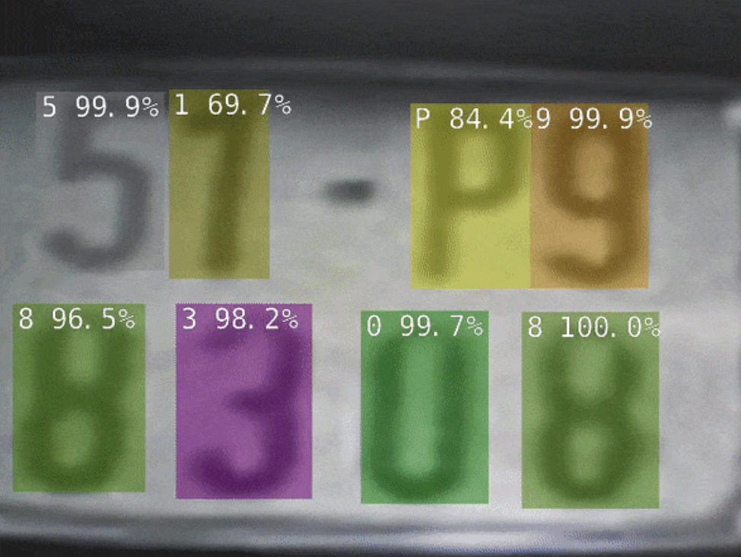
1. INTRODUCTION
Automatic License Plate Recognition (ALPR) has been a frequent topic of research due to many practical applications.
Notes:
Automatic License Plate Recognition (ALPR) has been a frequent topic of research due to many practical applications, such as automatic toll collection, traffic law enforcement, private spaces access control and road traffic monitoring. ALPR systems typically have three stages: License Plate (LP) detection, character segmentation and character recognition.

Slide 4
1. INTRODUCTION
The main contributions of this work can be summarized as follows:
A new real-time end-to-end ALPR system using the state-of-the-art YOLO object detection CNNs.
A robust two-stage approach for character segmentation and recognition mainly due to simple data augmentation tricks for training data such as inverted LPs and flipped characters.
A public dataset for ALPR with 8000 fully annotated images (over 60,000 LP characters) focused on usual and different real-world scenarios.

Slide 5
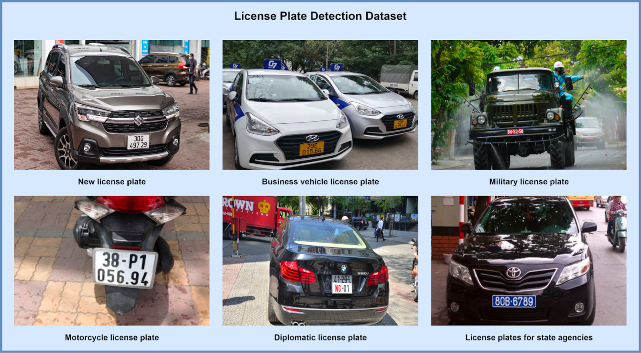
2. THE ALPR DATASET
The dataset contains 8,000 images taken from parking lots over a variety of times and vehicles.
Private vehicles have white LPs, while buses, taxis and other transportation vehicles have yellow, blue, red LPs.

Slide 6
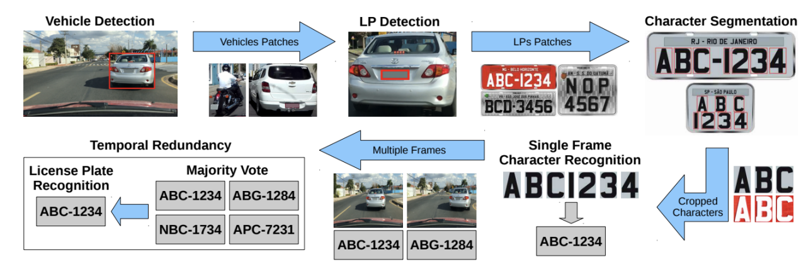
3. PROPOSED ALPR APPROACH
Fig. 2 illustrates the ALPR pipeline, explained throughout this section.
Fig. 2. An usual ALPR pipeline having temporal redundancy at the end.
Notes:
We train two CNNs in this stage: one for vehicle detection in the input image and other for LP detection in the detected vehicle.
While the entire frame and the vehicle coordinates are used as inputs to train the vehicle detection CNN, the vehicle patch (with a margin) and the coordinates of its LP are used to learn the LP detection network.

Slide 7
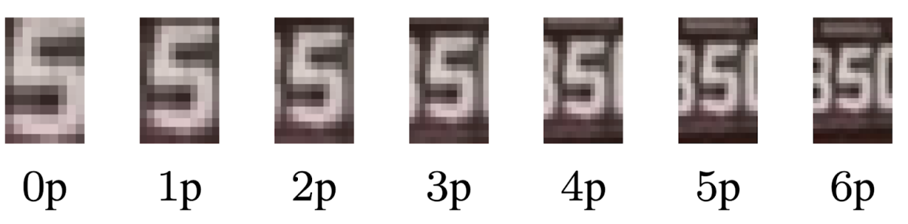
3. PROPOSED ALPR APPROACH
Since many characters might not be perfectly segmented, containing missing parts, and as each character is relatively small, even one pixel difference between the ground truth and the prediction might impair the character’s recognition.
Fig. 3. Comparison of different values of padding.
Notes:
Therefore, we evaluate different padding values (1-3 pixels) in the segmented characters to achieve higher recognition rates.
As Fig. 3 illustrates, the more padding pixels the more noise information is added (e.g., portions of other characters or the LP frame).

Slide 8
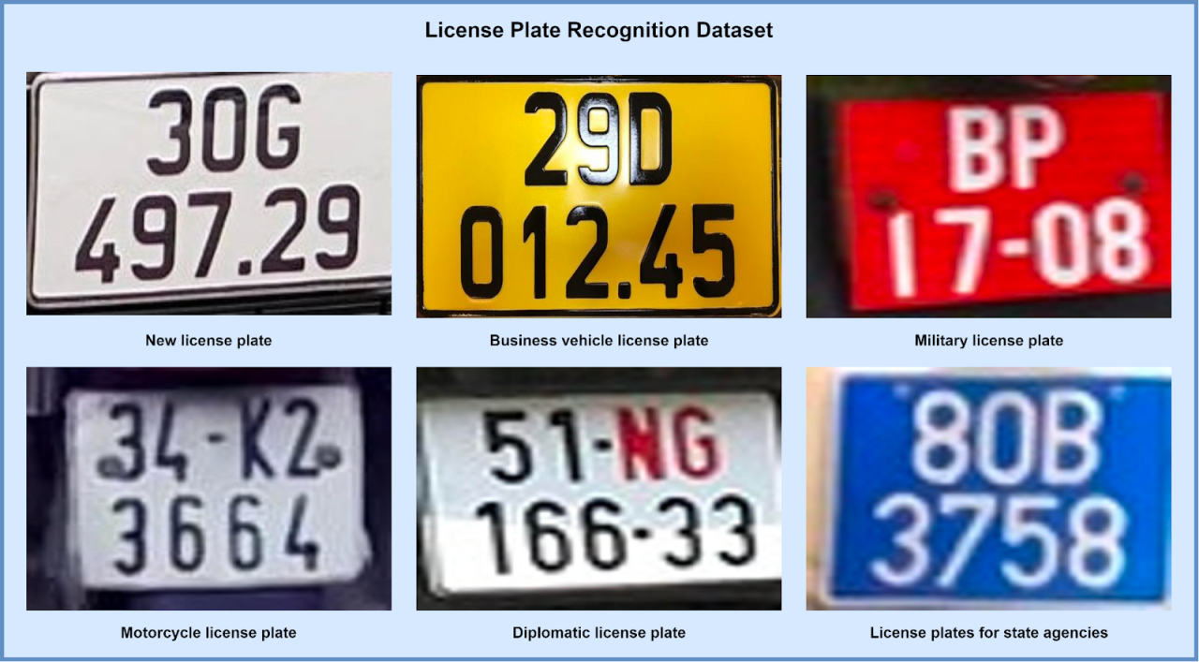
3. PROPOSED ALPR APPROACH
Having knowledge of the specific LP country layout (e.g., the Vietnam layout), we know which characters are letters and which are digits by their position.
Notes:
Having knowledge of the specific LP country layout (e.g., the Vietnam layout), we know which characters are letters and which are digits by their position.
We sort the segmented characters by their horizontal and vertical positions for cars and motorcycles, respectively.
The first three or four characters correspond to the letters or digits and the last four or five to the digits, even in cases where the LP is considerably tilted.
It is worth noting that a country (e.g., USA) might have different LP layouts, so this approach would not be suitable in such cases.

Slide 9
4. CONCLUSIONS
A robust real-time end-to-end ALPR system using the state-of-the-art YOLO object detection CNNs.
The proposed ALPR system is robust to locate vehicle, LPs and alphanumeric characters from any other country.
Notes:
In this work, I have presented a robust real-time end-to-end ALPR system using the state-of-the-art YOLO object detection CNNs.
my system was conceived and evaluated on country-specific dataset from Vietnam,
I believe that the proposed ALPR system is robust to locate vehicle, LPs and alphanumeric characters from any other country. In this direction, aiming a fully robust system we just need to design a character recognition module that is independent of the LP layout.

